Slide 1
Streamlining School Improvement
MACAE Spring Conference
May 18, 2017

Slide 2
Outcomes for Today
What reports are due for 2016-1017 school year?
What are the Optional choice for Goals/ Plans?
Using School Systems Review for Improvement Planning

Slide 3
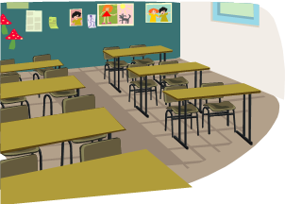
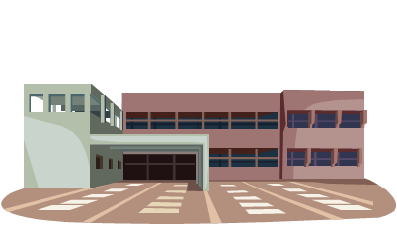
Public Act 25 of 1990
3-5 year
plan

Slide 4
What is School Improvement?
Turn and Talk

Slide 5
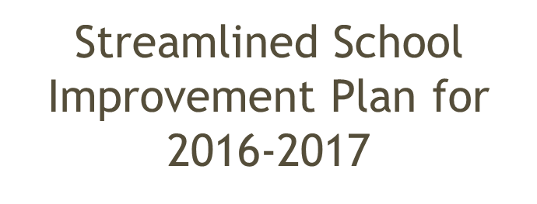
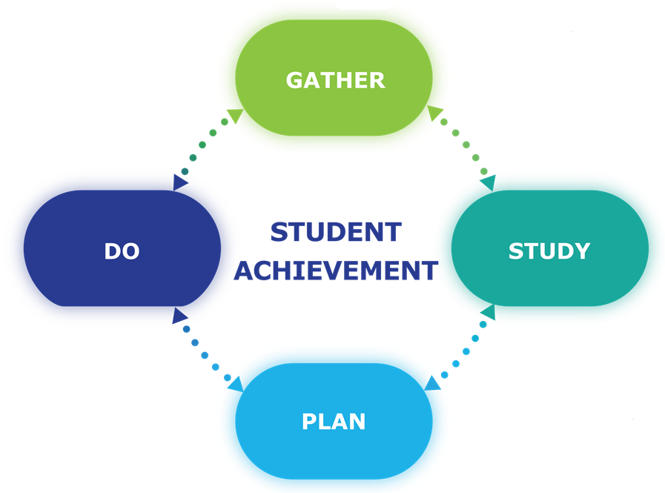
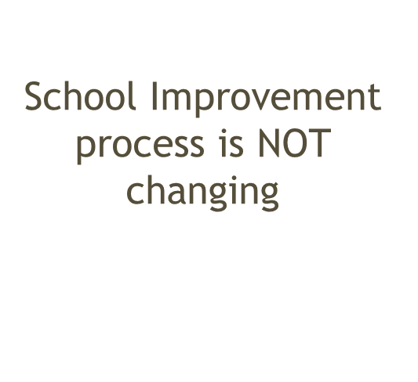
Comprehensive
Needs Assessment
(CNA)

Slide 6
What’s Changed?
2015 – 2016 Reports
2016 – 2017 Reports
Career & College Ready Implementation Status (CCRIS)
Program Evaluation
Focus School Report
District Resource Allocation
Single Building District Resource Allocation
EdYES!
District Requirements Report
District Improvement Plan
Single Building District Improvement Plan
Priority Single Building District Improvement Plan
School Improvement Plan
Priority School Improvement Plan
EdYES!
District Requirements Report
District Improvement Plan
School Improvement Plan
Notes:
A number of reports have been eliminated or combined, resulting in a more streamlined reporting cycle.

Slide 8
The following reports have been assigned for the 2016-2017 school year:

Slide 9
DISTRICT REPORTS

Slide 10
SINGLE BUILDING DISTRICT
Ed YES!
Program Evaluation
Single Building District Improvement Plan

Slide 11
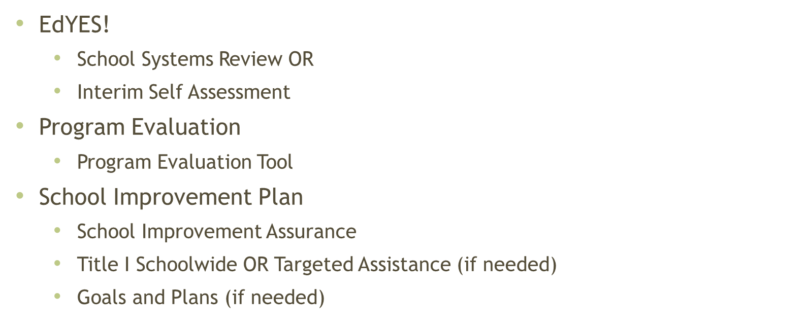
SCHOOL REPORTS

Slide 12
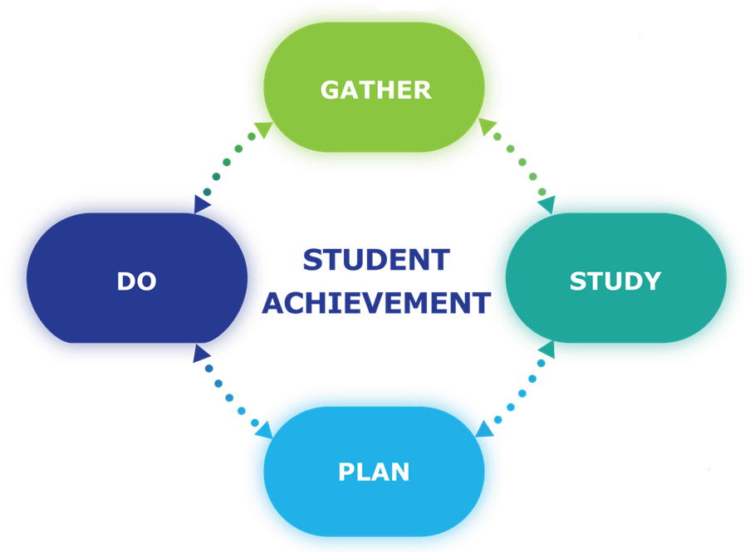
TURN and TALK
Which part of the Reporting Process has been most challenging for your school, program or district?
Which part of the Reporting Process has been most successful for your school, program or district?

Slide 13
Streamlined SIP for 2016 – 2017
Two options for streamlining:
Update Goals and Plans / Continue as usual
Complete PA25 Template

Slide 14
PA 25 Template

Slide 15
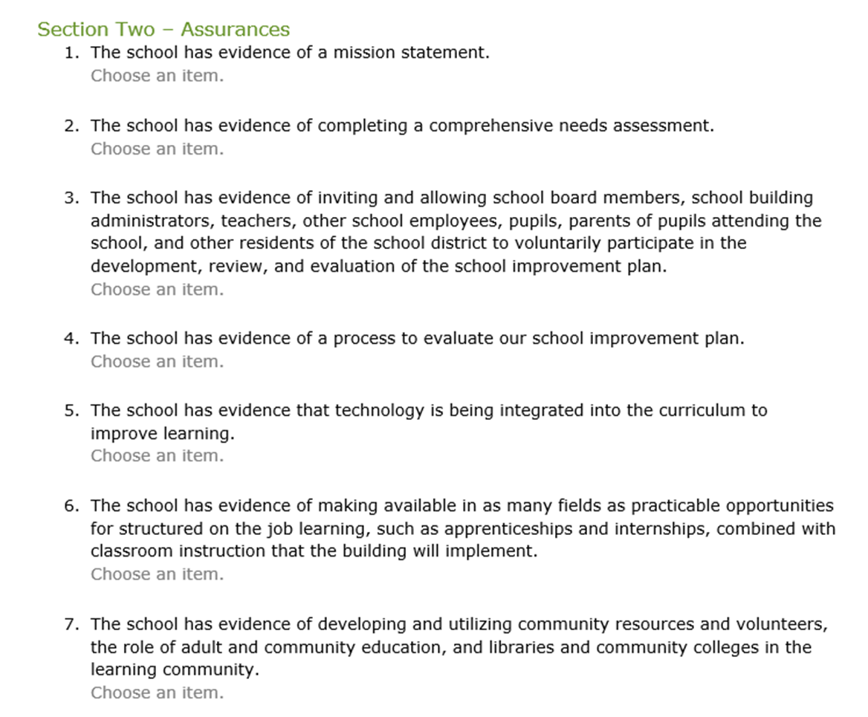

Slide 16
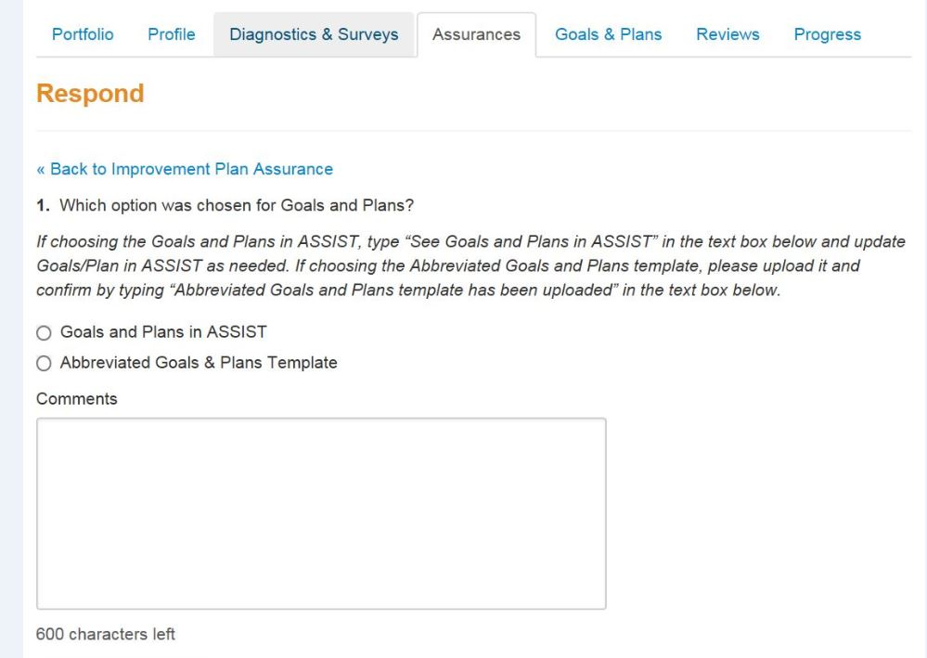
Abbreviated Goals and Plans Template

Slide 17
Use the abbreviated format

Slide 18
Continue with completion of Goals and Plans as you have always done

Slide 22
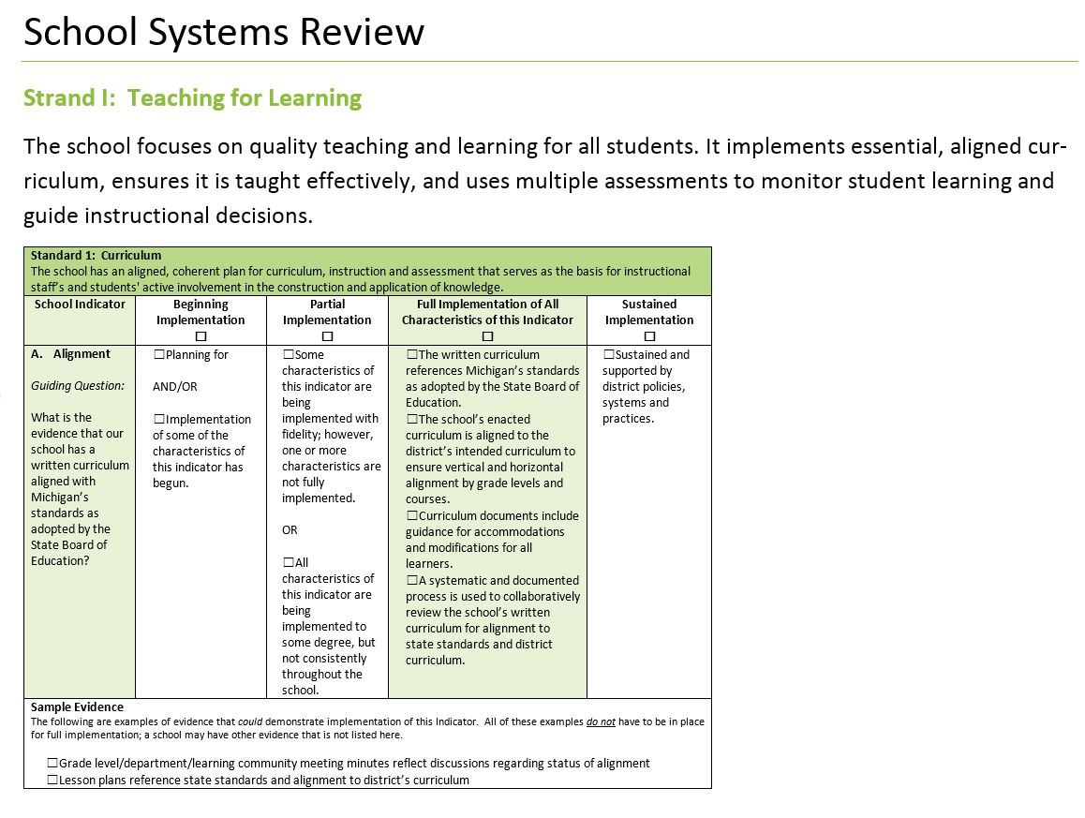
Sample of SSR

Slide 24
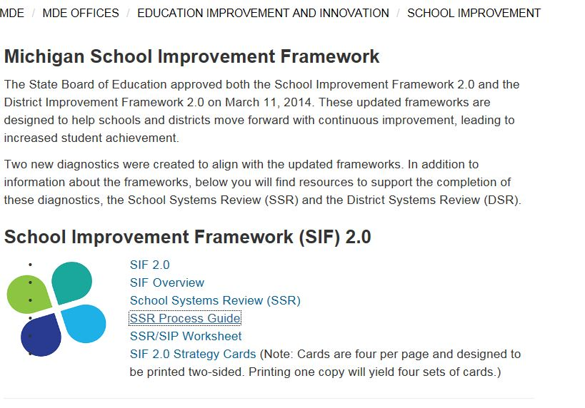
http://www.michigan.gov/mde/0,4615,7-140-6530_30334_37563-340775--,00.html

Slide 25
What Questions might you have?

Slide 26
Michigan Department of Education
Renie Araoz
AraozR@Michigan.gov
Diane Fleming
Flemingd6@Michigan.gov
Diane Joslin-Gould
Joslin-Gouldd@Michigan.gov

