Slide 1
Accountability for Alternative Schools
Overview of Michigan’s Proposed System
MACAE 5/18/2017
Alexander Schwarz

Slide 2
Introduction

Slide 3
Clarification on Timelines
2016-17 accountability (Fall 2017) will be a pilot run of the new, opt-in proposed system
2017-18 accountability (Fall 2018) will be an operational run of the new, opt-in system

Slide 4
Clarification on Status of Proposed System
As stated above, this is a PROPOSED system, it is being finalized for submission.
Many elements are required by law and therefore cannot change.
Some elements are more subject to interpretation and were opened to public comment.

Slide 5
ESSA and Alternative Accountability
ESSA reduces the federal role in education accountability decisions.
ESSA eliminates many of the prescriptive requirements from NCLB and allows states greater leeway in designing their own accountability systems.
MI Alternative Accountability is part of our overall ESSA submission, and will parallel much of the logic of the ESSA Scorecard.

Slide 6
NCLB Requirements Continued Under ESSA
Annual assessment of all students grades 3-8 & 11 in math & ELA
Annual accountability reporting
Disaggregation of data by student groups
Minimum size of student group before data is disaggregated
Minimum time of enrollment before students’ results can be included

Slide 7
Alternative Accountability Overview

Slide 8
Alternative vs. Traditional Accountability
Most alternative education-focused entities are not accountable through existing assessment based identifiers as most students are not present long enough to be considered FAY for those existing accountability systems.
Alternative education-focused entities may not have enough enrolled students at the time of the assessment snapshot to meet the minimum enrollment for other components of existing accountability.
With traditional accountability many schools aren’t measurable. We envision a system with further feedback and differentiation.

Slide 9
Many Entities Receive no Accountability
2,700 entities received a School ranking
3,400 entities received a Scorecard color
There are over 4,000 potentially eligible entities in Michigan

Slide 10
Accountability Implications
Schools will need to weigh the following when deciding to participate:
Will not receive ESSA Scorecard
May not receive Letter grade
But an alternative option will give schools some freedom to “choose their accountability”

Slide 11
Proposed Eligibility Requirements
EEM
Unique entity code (building code)
Entity type is ISD/LEA/PSA school
School Emphasis is “Alternative Education”
Educational Settings Authorized includes “Alt”
Not identified as a SEE
MSDS
100% of students reported with alternative education code (9220) in Program Eligibility Participation section of Spring MSDS General collection

Slide 12
Accountability Options

Slide 13
Overview of the Proposed System

Slide 14
System Highlights
Possible single overall A-F letter grade or label; Pass/Fail for schools missing key data
Based on performance in 6 areas:
Participation
Proficiency
Student growth
Student attainment
Chronic absenteeism
Student course completion

Slide 15
System Highlights (continued)
Letter grade or label for each indicator and student group with enough data
Building-level only; districts will not receive labels but will have data included in a separate public transparency dashboard
Informational only indicators
Student groups meeting targets
Similar school performance comparison quadrant display of proficiency and growth

Slide 16
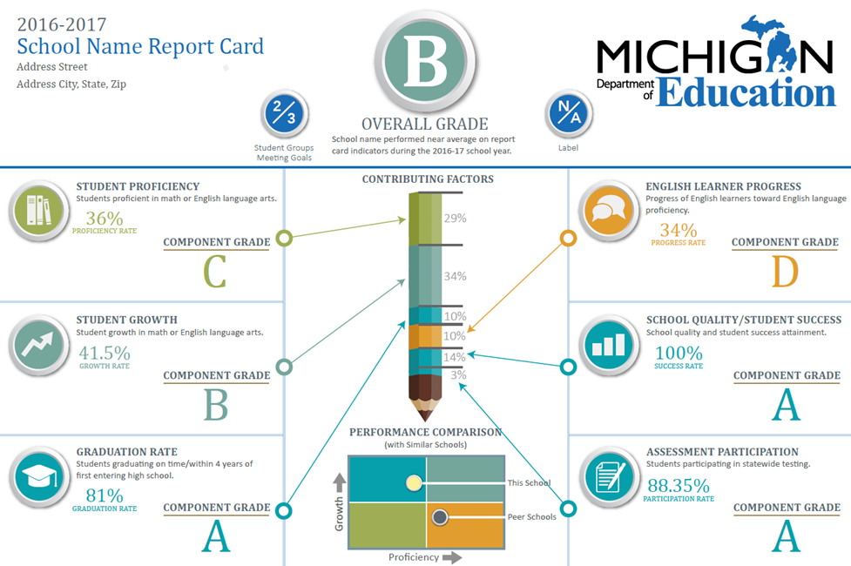
Possible Report Card Display

Slide 17
Overall Label & Index

Slide 18
DRAFT Overall Building Labels
Overall Label | Definition (Percent of Target Met)
A | 90% to 100%
B | 80% to less than 90%
C | 70% to less than 80%
D | 60% to less than 70%
F | Less than 60%
Pass | 60% to 100%
Fail | Less than 60%
Schools having Proficiency, Growth, Graduation Rate, or EL Progress indicator data will receive a Letter Grade or Label
Schools having only some combination of Participation, EL Participation, and/or School Quality indicator data will receive a Pass/Fail overall label

Slide 19
DRAFT Weighting of Indicators in Overall Index
Indicator | Weight
Growth | 30%
Proficiency | 14%
Chronic absenteeism | 14%
Student attainment | 14%
Course completion | 14%
Participation | 14%
Weights show the proportion of the overall label determined by an individual indicator
Missing indicators will have their weights distributed proportionally to the remaining indicators

Slide 20
Student Attainment- Definitions
GED Completer
Completed Gen Ed with Certificate
Expected to Continue
Received Special Ed Completion Certificate
Special Ed- Reached Maximum Age

Slide 21
Referent Group Overview

Slide 22
Referent Group- Preferred Weighting
Student Growth and Course Completion were ranked highly
Group differed on most other components, with Attendance particularly variable
Student Attainment, Climate/Culture, Achievement, Participation and Compliance were generally ranked lower
Preference for using additional years of data

Slide 23
Feedback from Referent Group
Attendance: Traditional attendance measures are particularly difficult for alternative accountability- goal should be getting/keeping kids in school.
Assessments: State assessments are inadequate for alternate accountability proficiency measures; interest in local assessments.
Growth: Traditional metrics are problematic; local growth measures may be options.
Grad Rate: Broader completion rate instead of traditional graduation rate; maybe also use longer span (7-year cohort).
Climate: Interest in using some type of school climate surveys.

Slide 24
School Climate Surveys: MiSCAI
Michigan School Climate Assessment Instrument
The focus is more on the content, not the design.
Only 39 schools participated in the survey last year, but MDE is very eager to increase those numbers.
Working with districts to learn about other climate surveys.

Slide 25
Local Data Sources
Drafting wider statewide survey to understand what alternative schools are using for local data?
What about “off the shelf” assessments that target the population?
What about postsecondary FAFSA data (data public at building level)?

Slide 26
Questions? Comments?
Alexander Schwarz
schwarza@michigan.gov
517-373-1292

